Slide 1
Adaptive Minds: Enhancing Domain Versatility of LLMs Through Parameter-Efficient Fine-Tuning
10 February 2025, Master Thesis Final
Mehul Raj Kumawat
Notes:
-> Lazer Pointer; And be confident, You go This!! ;)
Good Afternoon Everyone. Welcome to the kick-off presentation of the Enhancing Domain Versatility of LLMs Through PEFT
------
Does DA of LLMs summarizes LR domains
--------
Rework the idea, ->
focus on 2 different questions
1. Teaching model new knowledge - from PEFT
best techniques that teaches model the best
2. how well the model will perform on Low Resource DA?
models sees 5 domains, 6th new domain, model leverages 5 DA knowledge and performs better on 6th one
[Zero shot -> ]
initial exps -> for knowing which techniques are better or best ones.

Slide 2
Outline
Background & Motivation
Research Questions
Datasets
Methodology
Results
Conclusion
Limitations and Future Work
Notes:
The outline we will follow during the presentation.

Slide 3
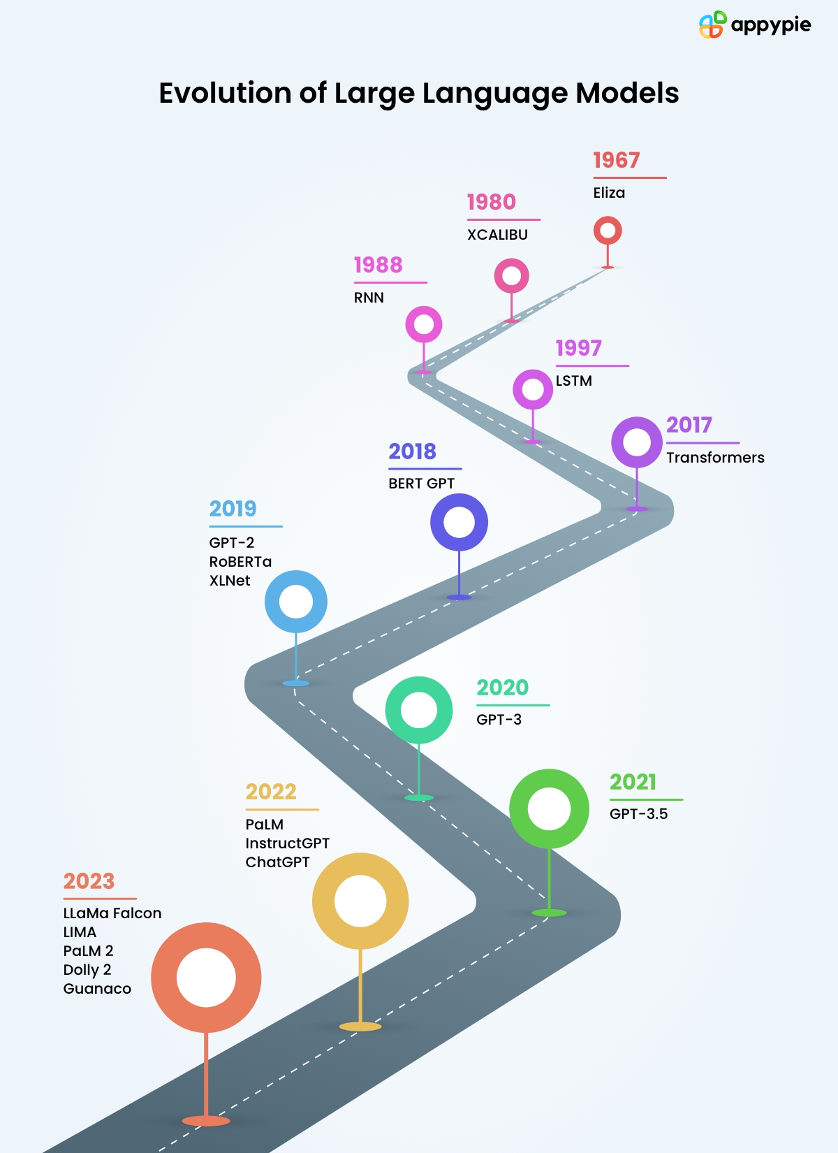
Background & Motivation
LLMs -Advancements in NLP
Generic task solvers
Achieved remarkable results
Growth of large corpus and hardware capacities
Lack new domain knowledge/domain expertise
https://www.appypie.com/blog/evolution-of-language-models
Notes:
timeline of LLMs [add image]
The recent advancvements inNLP has to be credited to LLMs,
these generic task solver have achieved remarkable results in almost all text based tasks they are given, be it reviewing, classification, question answering, and others.
This is because of the increasing size of the corpus and powerful hardware resources which allows for training of these systems.
But even after having such a huge knowledge base, they struggle at being domain experts, unless trained to be so.

Slide 4
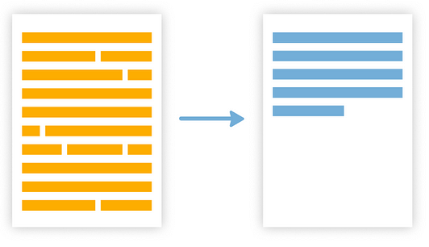
Background & Motivation
Low generalization ability on unseen Domains
E.g. new discovery, new technology, AI-generated data, etc.
Gap exists between the low-resource and high-resource data
Summarization
Small LLMs struggle in adapting to new data
https://medium.com/@abstractive-health/extractive-vs-abstractive-summarization-in-healthcare-bfe7424eb586
Yu, T., Liu, Z., & Fung, P. (2021). AdaptSum: Towards Low-Resource
Domain Adaptation for Abstractive Summarization. ArXiv. /abs/2103.11332
Notes:
=> On unseen data, its generalization ability decreases,
which can happen when there is a new discovery, or arrival of a new technology or may be some AI generated data. These are the data which are not seen by the LLMs during their initial training.
=> This case of low generalizability is more prominent in case of low-resource data, where labelled data is not easily available, and we see a significant gap in performance on high-resource data.
=> Another notable point is that when working with smaller LLMs it suffer with domain shift when provided with either a new task on a given data, or when asked to perform a task on new domain as compared to the larger LLMs.
=> Hence through our work we want to reduce the gap of domain shift in a Smaller LLM, when provided with a new low-resource domain. We leverage data from a few high-resource domains, and carry out the task of summarization on the low-resource data.
----------------------------------------------------------------------------------------
On unseen data, its generalization ability decreases, when a new data or domain comes, in case of new discovery, or new technology or may be some AI generated data. These are data which are not seen by the LLMs.
This case of low generalizability is more prominent in case of low-resource data, and there is a huge gap that exists from the high-resource data.
Another notable point is that when working with smaller LLMs they suffer with domain shift when provided with either a new task on a given data, or when asked to perform a task on new domain.
Hence through our work we want to reduce the gap of domain shift in a Smaller LLM, when provided it is provided a new low-resource domain. We leverage few high-resource domains, and carry out the task of summarization on the low-resource data.
________________________________________________________________
Hence, there is a gap that exists between low and high resource settings.
1. Bridge the gap between unseen domain and low resources
unseen domain -> different domains - what are these
=> low resource
2. Smaller models suffer from domain shift ->
domain adaptation means -> 1. new task; and 2. LLM learning new domain;
----- -> difference between domain and datasets.

Slide 5
Background & Motivation: Domain Adaptation Methods
Fine-tuning Methods:
Traditional fine-tuning (with and without freezing)
Parameter-efficient Fine-tuning (PEFT)
LM Prompting:
Zero-Shot Learning (Baseline)
In-Context Learning
Human Preferences Tuning
Notes:
To adapt domains, to perform various downstream tasks, in our case, summarization
We can utilize different methods like
Fine-tuning methods are:
LM Prompting (since LLMs are instruct tuned, we can give prompts to perform tasks. )
Zero Shot Learning – only an instruction or prompt
In-context Learning – instruction with a few examples.
Traditional FT, - training all wts, when we freeze wts, we train the wts of last layers.
PEFT: -– where we update a small set of parameters either by adding or updating some existing paramters.
Learn embeddings for placeholder tokens in the pattern.
Initialize using a vocabulary embedding
Human Preferences Tuning – uses Reinforcement Learning with Human interactions - not included in the scope of the project.
___________________________________________________________________________________________________________________
for enc-dec
Decoder architecture ->
LMs FT using enc-dec model,
**Careful with terminologies.
Focusing on Domain Adaptation ----- understanding different domains/ data it hasn't
chatbots - XXXX
Pose the idea - LMs struggle with adapting to understanding new vocabl
small models struggle with zero shot learning.
motivation to work on smaller language model, make them perform better from in-context learning.
Domain shift
adaptation on specific needs or domains.

Slide 6
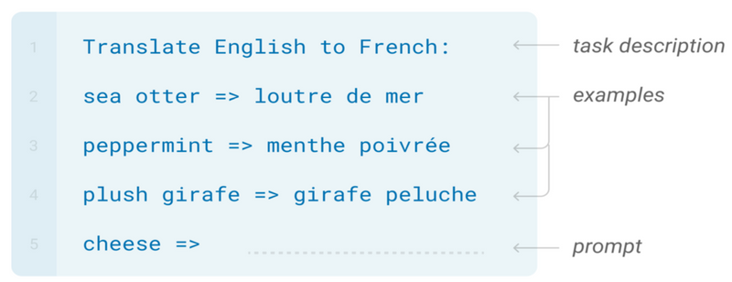
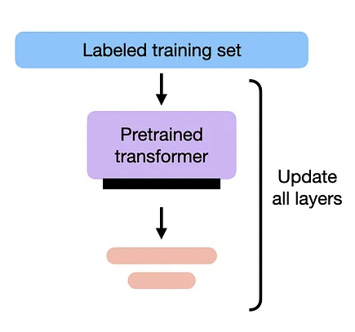
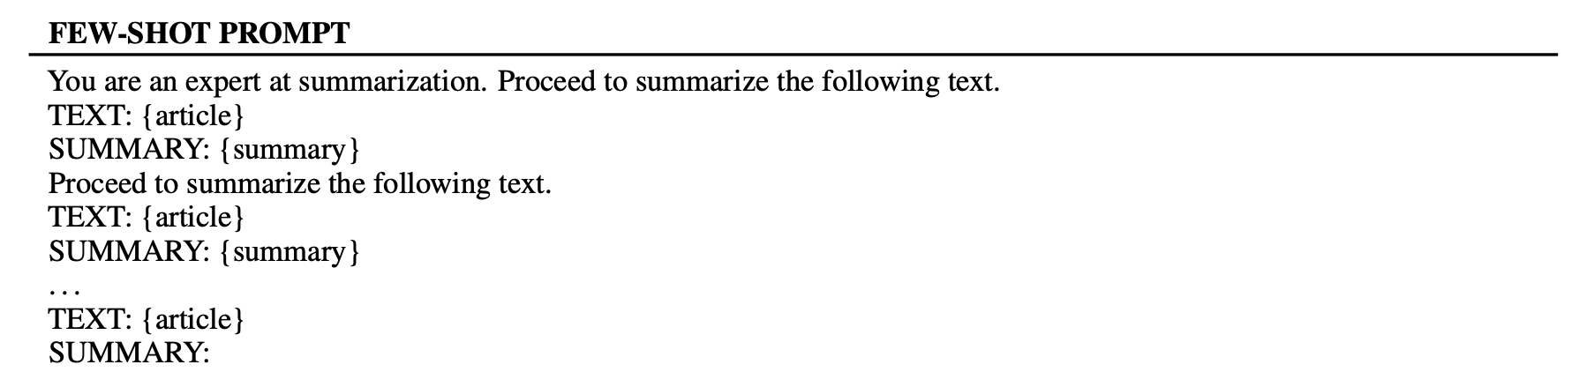
Background & Motivation: Fine-Tuning
In-Context Learning
Traditional Fine-tuning
Task of Translation from English to French
Full Fine tuning of a PLM on new labelled data
Task of Summarization of long text articles.
Anum Afzal, Ribin Chalumattu, Florian Matthes, and Laura Mascarell. 2024.
AdaptEval: Evaluating Large Language Models on Domain Adaptation for Text Summarization.
https://mlops.community/fine-tuning-vs-prompt-engineering-llms/
Notes:
ICL - > we provide examples, good for smaller tasks, but for the tasks like summarization where the input lengths are unknown, we might have context window limitations because of the hardware they are hosted on. We are also not sure how well the attention is distributed in the LLM so what parts of the prompts the attention will focus on.
Unfreezing some layers and let it adapt to new domain -> it can suffer from catastrophic forgetting.
-> we don't how well the attention is dristributed. hardware limitations,

Slide 7
Background & Motivation: PEFTs
Parameter Efficient Fine Tuning (PEFT)
Easy to use
Updates almost 1% model parameters
Preserves Original Model
Requires low training time
PEFTs
AdaLoRA
(IA)³
LoHA
LoKr
LoRA
OFT
https://huggingface.co/docs/peft/index
Notes:
** Add resources
Hence, we work with PEFTs.
They update almost 1% of model parameters and this allows for preserving most of the original model. And since the number of params updated during the fine-tuning in very very less as compared to original model parameters, the training time required is very less. They are very easy to add to the models, and are easy to use as per the need.
In our work we explore 6 PEFTs:
Adaptive Low-Rank Adaptation or AdaLoRA
Infused Adapter by Inhibiting and Amplifying Inner Activations or (IA)3
LoHA or Low-Rank Hadamard Product
Low-Rank Kronecker Product
Orthogonal Fine-tuning
In this work we use Adapter based PEFTs, except for IA3 which uses learned vectors instead of proper weight matrices.
_______________________________________________________________________________________________________________________________________
Why do we need DA?
Since general purpose models are impossible one-fits-all solvers, domain adaptation allows us to be more specific to domains for particular tasks, where we require in-depth knowledge for better understanding of concepts.
Since, DA is applied where the source and target domains are from different distributions. Implying it helps in tackle domain shift.
Domain adaptation is a special case of transfer learning that only covers the change of the data domain.
the source and target domains all have the same feature space (but different distributions).
in contrast, transfer learning includes cases where the target domain's feature space is different from the source feature space or spaces.
It also allows to cover languages style where differences are significant.
___________________________________________________________________________________________________________
Domain Shift-> is a change in the data distribution between an algorithm's training dataset, and a dataset it encounters when deployed.
apply an algorithm trained in one or more source domains to a different target domain
the source and target domains all have the same feature space (but different distributions)
in contrast, transfer learning includes cases where the target domain's feature space is different from the source feature space or spaces.
- Domain shift
- General-purpose models are impossible one-fits-all solver
- Requirement of in-depth knowledge
- Significant differences in language styles
-------------------------------------------------------------------------------------------
-> LLM forgets initial knowledge [BitFIt]

Slide 8
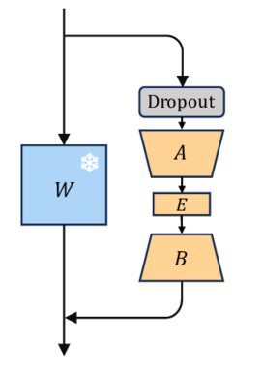
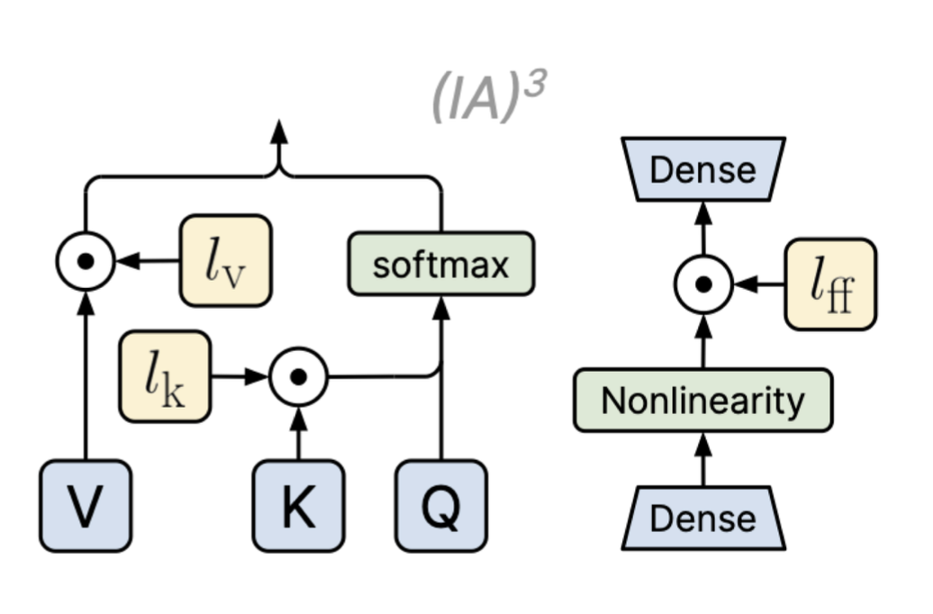
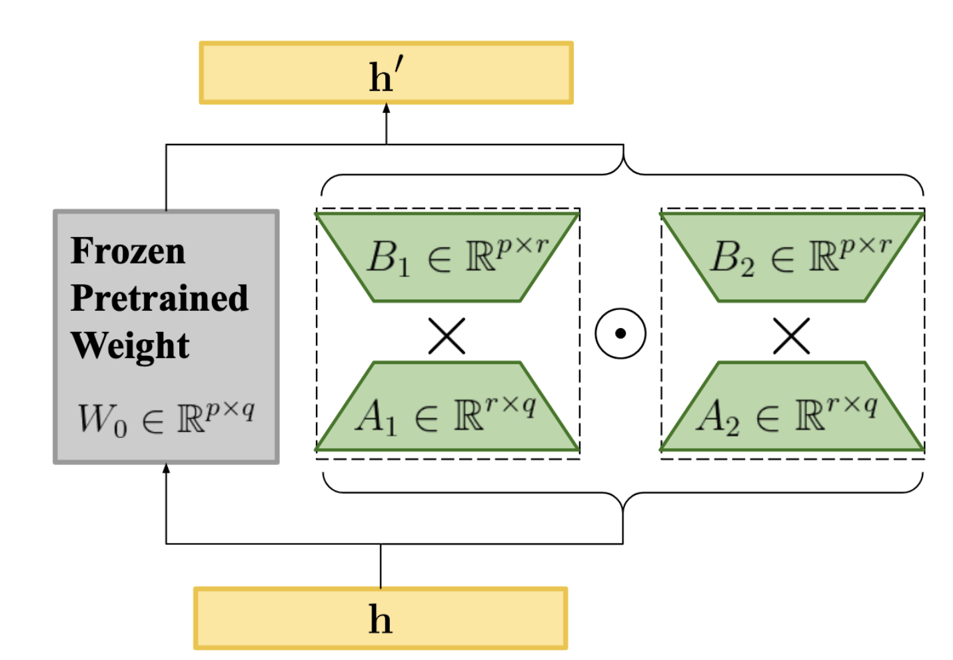
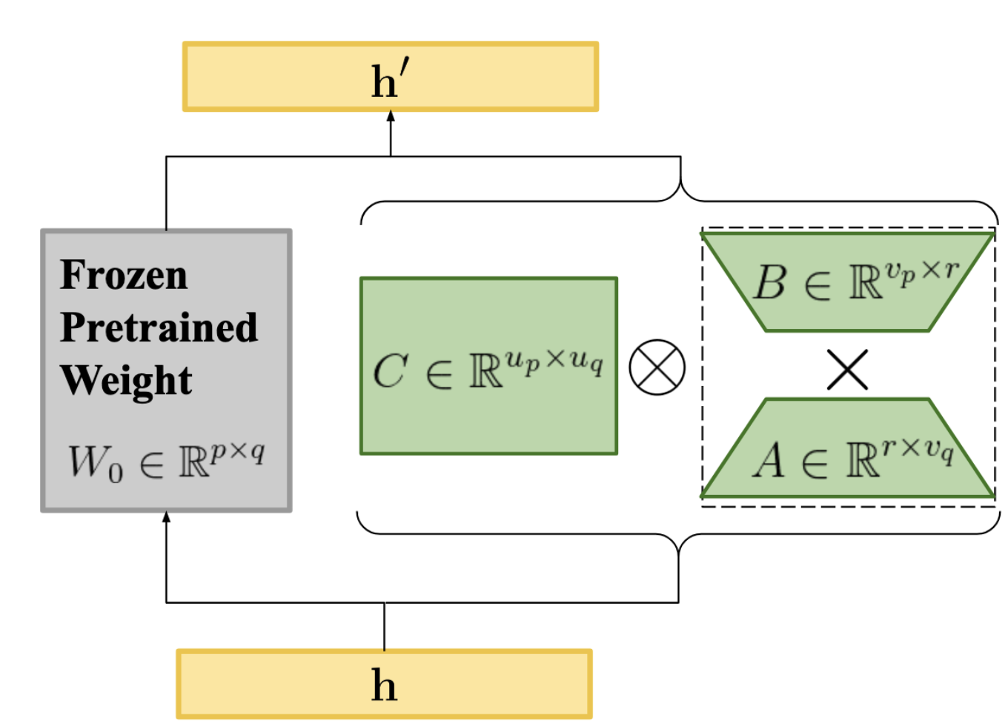
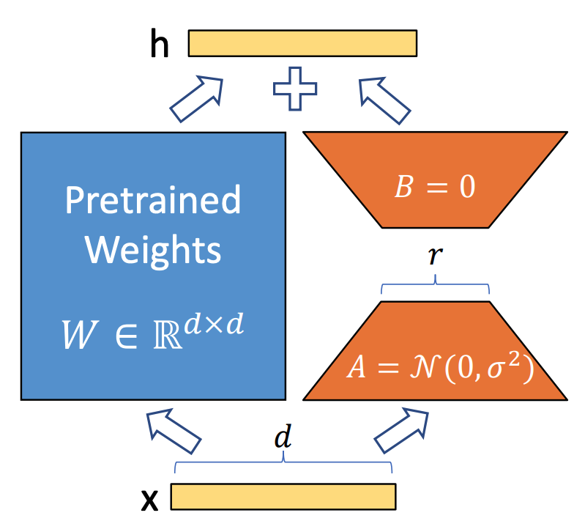
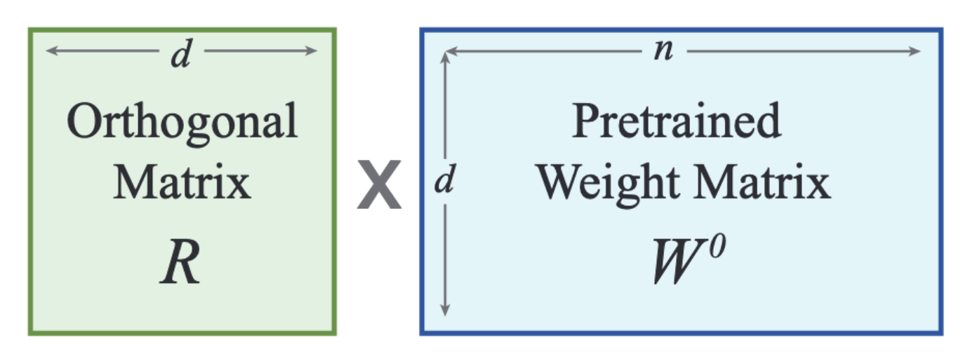
Background & Motivation: PEFTs
AdaLoRA
(IA)³
LoHA
LoKr
LoRA
OFT
https://huggingface.co/docs/peft/index
Notes:
** Add resources
In our work we explore 6 PEFTs:
Adaptive Low-Rank Adaptation or AdaLoRA
optimizes the number of training parameters to assign to weight matrices by budgeting to more important weights, and less important ones get fewer parameters
Infused Adapter by Inhibiting and Amplifying Inner Activations or (IA)3
method adds learned vectors for rescaling the keys and values of the self-attention layers (and encoder-decoder attention )
LoHA or Low-Rank Hadamard Product
Combines a more number smaller matrices as compared to other low rank methods using the Hadmard Product
Low-Rank Kronecker Product
combines two smaller, low-rank matrices using the Kronecker product as compared to LoRA.
Low Rank Adaptation
takes a large matrix and decomposes it into two smaller low-rank matrices
Orthogonal Fine-tuning
reconfigures the pre-trained weight matrices using their orthogonal counterparts, which helps maintain the information contained in the original model.
-------------------------------------------------------------------------------------
AdaLoRA: AdaLoRA dynamically allocates low-rank parameters during fine-tuning, enabling adaptive and efficient model adaptation with minimal extra parameters.
(IA)³: (IA)³ fine-tunes specific model activations to achieve targeted adaptation, minimizing parameter updates while enhancing task-specific performance.
LoHA: LoHA enhances domain-specific performance by incorporating low-rank modifications into the attention mechanisms of the model, maintaining efficiency with minimal added parameters.
LoKr: LoKr reparameterizes kernel layers with low-rank adaptations, improving the model's ability to specialize in new tasks without full-scale retraining.
LoRA: LoRA injects low-rank matrices into pre-trained model weights, drastically reducing the number of trainable parameters required for effective fine-tuning.
OFT: OFT enables on-the-fly fine-tuning by dynamically updating model parameters during inference, providing a resource-efficient approach to domain adaptation.

Slide 9
Outline
Background & Motivation
Research Questions
Datasets
Methodology
Results
Conclusion
Limitations and Future Work

Slide 10
Research Questions
Research Question 1
Can a smaller Large Language Model (LLM) adapt well to an unseen domain using a parameter-efficient fine-tuning method and perform effectively on the task of summarization?
Research Question 2
Can we leverage multiple parameter-efficient fine-tuning techniques to enable an LLM to simultaneously learn and perform well across various domains?
Research Question 3
Are there parameter-efficient fine-tuning techniques that enable an LLM to adapt well to a specific domain, or do they perform with similar efficacy across multiple domains?
Research Question 4
After training an LLM on multiple high-resource domains, can it achieve strong performance on an unseen low-resource domain?
Notes:
Q1. Can a smaller Large Language Model (LLM) adapt well to an unseen domain using a parameter-efficient fine-tuning method and perform effectively on the task of summarization?
for our PoCwe adapted Medical and Scientific domain and we were able to generate some results with a few epochs, we trained our model on 500 samples.
Q2. Can we leverage multiple parameter-efficient fine-tuning techniques to enable an LLM to simultaneously learn and perform well across various domains?
In our PoC we adapted Medical and Scientific domain, we simulatenously tried training 2 different techniques – LoRA and IA3 with Pubmed and Arxiv Respectively..
Q3. Are there parameter-efficient fine-tuning techniques that enable an LLM to adapt well to a specific domain, or do they perform effectively across multiple domains for an LLM?
is one domain easily adaptable than another, if so why is it so?
Q4. After training an LLM on multiple high-resource domains, can it achieve strong performance on an unseen low-resource domain?

Slide 11
Outline
Background & Motivation
Research Questions
Datasets
Methodology
Results
Conclusion
Limitations and Future Work

Slide 12
Datasets
Domains
Scientific
Medical
Legal
News
Scientific
Arxiv
Elsevier
SciTLDR
Medical
CORD-19
MSLR
PubMed
SciLay
Legal
BillSum
Eur-Lex-Sum
Multi-Lex
News
CNN/DM
Multinews
Cornell Newsroom
XSum
https://huggingface.co/docs/datasets/en/index
https://lil.nlp.cornell.edu/newsroom/index.html
Notes:
** Add resources
In this project, we explore four high-resource domains – S, M, L, and N.
With 3 datasets in S, 4 in M, 3 in L, and 4 in N, to cover the variations in language. Each of this dataset covers a different aspect of the domain they represent.

Slide 13
Datasets
Holdout Validation Dataset
Scientific
Medical
Legal
News
Scientific
ACLSum
Medical
BMJ Medical Research
Legal
Indian and UK legal Cases
News
InShorts Summarized News
Note: These datasets are not seen by the model or PEFTs during training or fine-tuning.
https://huggingface.co/datasets/sobamchan/aclsum
https://www.bmj.com/research/research
(https://aclanthology.org/2022.aacl-main.77/) (Shukla et al., AACL-IJCNLP 2022)
https://inshorts.com/en/read
Notes:
** Add resources
add footnote about unseen by model
To emulate the real world setting, In addition to the high-resource domain, we provide results on four low-resource holdout validation datasets , one from each of the domains that we had in training.
S , M, L, and N

Slide 14
Datasets
Table 1: Average number of tokens in article and summary in each dataset
Notes:
-> highlight variation in length
Largest Average len -> Legal, news has shortest lengths.

Slide 15
Outline
Background & Motivation
Research Questions
Datasets
Methodology
Results
Conclusion
Limitations and Future Work

Slide 16
Methodology
Notes:
Data pre-processing, we provide the article and summary to a prompt and allow the LLaMA3-8B-Instruct model with a PEFT to learn from the data. We use the CausalLM training regime which is basically, predicting the next word given some context.
In the evaluation pipeline, we compare the ground truth with generated summary using evaluation metrics which we will see later, and we provide with Human evaluation on the final set of results which we’ll see in the results.

Slide 17
Methodology: Training
AdaLoRA
0.3384%
(IA)³
0.0098%
LoHA
1.3398%
LoKr
0.0098%
LoRA
0.6744%
OFT
0.2215%
Notes:
Training Methodology has 2 step process – Instruction-Tuning and Adapter Training.
During training one of the six PEFTs is attached to the LLaMA3-8B-Instruct Model. And the percentage shown here tells how many model parameters were updated during FT process. The attached PEFT was loaded with peft library from HF. The PEFT were added to all the layers of the attention block. We could only train one PEFT in one training process. We fine-tuned our model with 5 epochs and in 1000 samples and selected the best_model checkpoint.
** Add resources
*Cover multiple domains so that low-resource domains are covered

Slide 18
Methodology: Inference
Notes:
Zero-shot learning was our Baseline.
Inference in 3 different settings ->
1. No domain
2. within-domain combination
3. cross-domain combination
Selecting the best PEFT based on the scores across 4 metrics, and using the Borda Count method for getting the highest scoring PEFTs across the four metrics.

Slide 19
Methodology: Inference
Inference Test data splits
Inference on Holdout Validation datasets
Notes:
we generate inference on two kinds of data,
1. On the test splits of the training data:
3 -> different settings ->
1. individual pefts [No-Domain]
2. within-domain combination
3. cross-domain combination
2. On the holdout valdiation-set.
2 -> different settings ->
1. within-domain combination - single pefts -> selected the best to get dataset and domain winners. for creating combinations.
2. cross-domain combination
For Selecting the best PEFTs for the combination settings, we used scores from the evaluation metrics, and found the final rankings using the BORDA Count Method.

Slide 20
Methodology: Evaluation Metrics
ROUGE
Measures the overlap of n-grams
BLEU
Measures the precision of n-grams
BERTScore
FActScore
Evaluates similarity of BERT embeddings
Human Evaluation
Measures Factual correctness using OpenAI APIs
Summary preferences given by humans
METEOR
Measures the harmonic mean between recall and precision
Perplexity
Measures performance of a LM
https://en.wikipedia.org/wiki/BLEU
https://en.wikipedia.org/wiki/ROUGE_(metric)
https://en.wikipedia.org/wiki/METEOR
Zhang, T., Kishore, V., Wu, F., Weinberger, K. Q., & Artzi, Y. (2019). BERTScore: Evaluating Text Generation with BERT. ArXiv. /abs/1904.09675
FActScore: Fine-grained Atomic Evaluation of Factual Precision in Long Form Text Generation (Min et al., EMNLP 2023)
Notes:
** Add References.
Evaluation Metrics:
Training evaluation -> Perplexity: how well a LM predicts the next word.
Summary evaluation: ROUGE, BLEU, Meteor: [n-gram based metrics, calculating recall, precision and hm means]
Meteor: calculated based on the harmonic mean of precision and recall,
with recall weighted more than precision.
FActScore - measure factual correctness by breaking down text into atomic facts and computes the fraction of these facts supported by a reliable knowledge source (wikipedia)
Human evaluation
__________________________________________________
Add LLM as a judge, GPT-4 and Human Evaluation
consistent evaluations across different summaries
add perplexity

Slide 21
Outline
Background & Motivation
Research Questions
Datasets
Methodology
Results
Conclusion
Limitations and Future Work

Slide 22
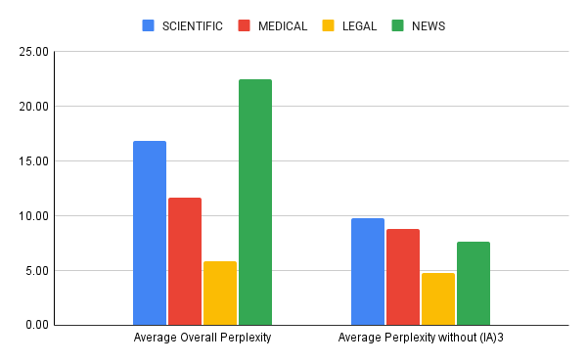
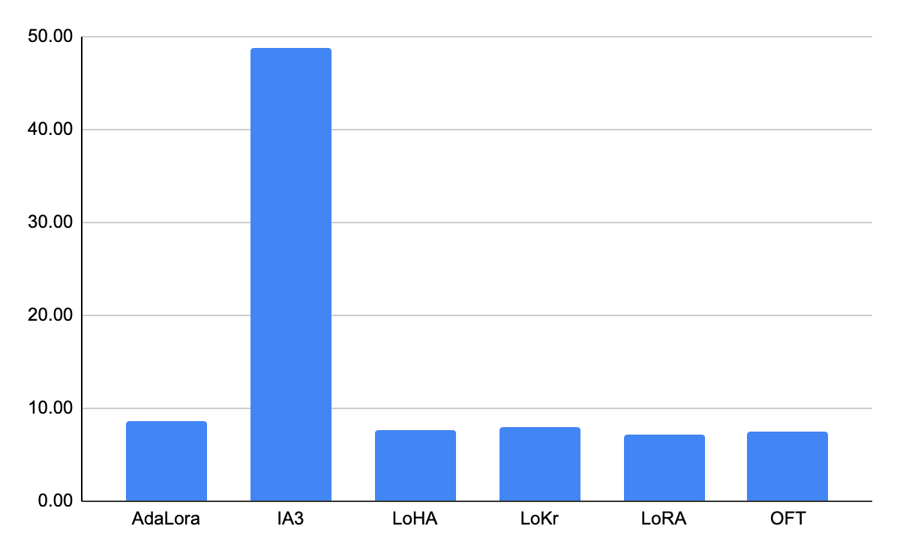
Results: Perplexity
Graph 1: Average perplexity score of each PEFTs across 14 datasets
Graph 2: Average perplexity scores across domains with and without (IA)³.
Notes:
we report PPL scores, showing how well the models have learned during FT.
THe more the score, the worst the performance, and IA3 has the worst training performance from graph 1.
From Graph2, if we remove the IA3 scores, the avg PPL across domain decreases, comes below 10, meaning the FT LLMs have 10 options to chose from for a given context.

Slide 23
Results: Scientific Domain
Table 2: Results on Scientific domain test data splits from each dataset from Zero shot, best individual PEFT and best combination from within-domain and cross-domain.
Notes:
The best PEFTs are selected from the 150 samples [in Appendix]
These Results are on 50 samples.
Scientific Test Splits on all datasets, we provide a comparison zero-shot, with the best performer single adapter with combination settings.
The single adapters are by far the best performers and have cleared the baseline scores in every metric.
Except for ZeroShot SciTLDR on METEOR.

Slide 24
Results: Medical Domain
Table 3: Results on Medical domain test data splits from each dataset from Zero shot, best individual PEFT and best combination from within-domain and cross-domain.
Notes:
Results on 50 samples.
In medical domains datasets, the story is same with the best performers being hte Single PEFTs, but there are combination settings which perform better than zero shot in case of CORD19 and PUBMED. Within domain combination performing better than the cross domain.

Slide 25
Results: Legal Domain
Table 4: Results on Legal domain test data splits from each dataset from Zero shot, best individual PEFT and best combination from within-domain and cross-domain.
Notes:
Results on 50 samples.
In legal domain too, Single Adapters are best Performers, but no combination can challenge the baseline.

Slide 26
Results: News Domain
Table 5: Results on News domain test data splits from each dataset from Zero shot, best individual PEFT and best combination from within-domain and cross-domain.
Notes:
Results on 50 samples.
Individual PEFTs has drastic enhancement in performance gains than zero-shot.
In multinews, the cross combination of Arxiv-LoKr from scientific+ BillSum-LoKr from legal and PubMEd-LoRA from medical and BillSum-LoKr has better gains than zero shot, if not the best as the Multinews-LoRA.
This shows that the combinations of PEFTs trained from different datasets can give better performance on some datasets.
We test out this theory with our results on the HVD.

Slide 27
Results: Holdout Validation Dataset
Dataset | Dataset-PEFT(s) | ROUGE |  |  | BERTScore | BLEU | METEOR | FActScore
 |  | Rogue1 | Rouge2 | RougeL |  |  |  | Score | NumFacts
Scientific | Zero-Shot | 0.3502 | 0.1397 | 0.2048 | 0.8766 | 0.0652 | 0.3873 | 0.9738 | 29.0800
 | (WID) SciTLDR-AdaLoRA + Elsevier-(IA)³ | 0.4024 | 0.1734 | 0.2491 | 0.8828 | 0.1120 | 0.3865 | 0.9651 | 17.6400
 | SciTLDR-AdaLoRA | 0.4124 | 0.1743 | 0.2534 | 0.8838 | 0.1058 | 0.3840 | 0.9706 | 15.7200
 | (CD) BillSum-(IA)³ + Newsroom-AdaLoRA | 0.3978 | 0.1667 | 0.2456 | 0.8806 | 0.1004 | 0.3757 | 0.9498 | 18.3600
 | Elsevier-(IA)³ | 0.3454 | 0.1439 | 0.2062 | 0.8777 | 0.0677 | 0.3968 | 0.9722 | 29.3200
 | Arxiv-AdaLoRA | 0.3706 | 0.1561 | 0.2314 | 0.8776 | 0.0792 | 0.3820 | 0.9491 | 22.9200
Medical | Zero-Shot | 0.4082 | 0.1990 | 0.2482 | 0.8526 | 0.0598 | 0.2178 | 0.9514 | 26.4400
 | CORD19-OFT | 0.4347 | 0.2293 | 0.2485 | 0.8611 | 0.0773 | 0.2449 | 0.9469 | 34.8000
 | (WID) CORD19-OFT + MSLR-(IA)³ | 0.4215 | 0.2226 | 0.2466 | 0.8570 | 0.0787 | 0.2458 | 0.9466 | 34.6400
 | PubMed-LoKr | 0.4179 | 0.2038 | 0.2320 | 0.8527 | 0.0707 | 0.2349 | 0.9368 | 33.9200
 | (CD) SciTLDR-AdaLoRA + Newsroom-AdaLoRA | 0.3964 | 0.1938 | 0.2262 | 0.8432 | 0.0704 | 0.2256 | 0.9343 | 36.6000
 | MSLR-(IA)³ | 0.4132 | 0.2009 | 0.2418 | 0.8532 | 0.0619 | 0.2184 | 0.9696 | 28.2400
 | SciLay-LoRA | 0.3712 | 0.1808 | 0.2064 | 0.8402 | 0.0656 | 0.2127 | 0.9439 | 34.9600
Legal | Zero-Shot | 0.4395 | 0.2069 | 0.2515 | 0.8565 | 0.0694 | 0.2264 | 0.9136 | 25.2400
 | (WID) BillSum-(IA)³+ MultiLex-LoKr | 0.4560 | 0.2412 | 0.2758 | 0.8593 | 0.0856 | 0.2434 | 0.9115 | 28.7200
 | MultiLex-LoKr | 0.4575 | 0.2384 | 0.2719 | 0.8567 | 0.0838 | 0.2441 | 0.9169 | 28.2400
 | (CD) SciTLDR-AdaLoRA + Newsroom-AdaLoRA | 0.4259 | 0.2302 | 0.2660 | 0.8427 | 0.0925 | 0.2303 | 0.8710 | 31.6000
 | EurLex-(IA)³ | 0.4505 | 0.2266 | 0.2549 | 0.8581 | 0.0780 | 0.2392 | 0.9482 | 25.3600
 | BillSum-LoRA | 0.4197 | 0.2303 | 0.2569 | 0.8477 | 0.0857 | 0.2320 | 0.9005 | 31.4000
News | Zero-Shot | 0.3821 | 0.1706 | 0.2439 | 0.8925 | 0.0925 | 0.4132 | 0.9708 | 24.8400
 | Newsroom-LoKr | 0.4139 | 0.2475 | 0.3077 | 0.8920 | 0.1273 | 0.4730 | 0.9022 | 31.1600
 | (CD) SciTLDR-AdaLoRA+ BillSum-(IA)³ | 0.4305 | 0.2003 | 0.2900 | 0.8965 | 0.1216 | 0.4140 | 0.9681 | 17.9600
 | XSum-AdaLoRA | 0.4204 | 0.1888 | 0.2818 | 0.8950 | 0.1102 | 0.4112 | 0.9665 | 19.4400
 | CNNDM-AdaLoRA | 0.4170 | 0.1820 | 0.2691 | 0.8893 | 0.1019 | 0.4071 | 0.9608 | 17.9200
 | Multinews-AdaLoRA | 0.3810 | 0.1756 | 0.2560 | 0.8871 | 0.0854 | 0.4107 | 0.9666 | 23.6400
 | (WID) Newsroom-LoKr + Multinews-AdaLoRA | 0.3063 | 0.1800 | 0.2287 | 0.8733 | 0.0950 | 0.4051 | 0.8959 | 40.6800
Table 6: Results on Holdout Validation Dataset on Zero-shot, individual PEFTs from each respective domain’s datasets and best combinations from both settings – within-domain (WID) and cross-domain (CD).
Notes:
Results on 25 samples.
Here we report 5 metric scores.
Make story around Scientific.
In Scientific Dataset:
Our trained PEFTs are performing better than the zero-shot baseline, on almost all scores, and has just a touch below factuality scores than baseline.
The combinations in both settings are comparable if not the best performers on the holdout scientific set.
And the within-domain combination gives better and coherent results than cross domain.
In Medical Dataset:
The combination of CORD19-OFT + MSLR-(IA)³ has a comparable performance with the CORD-19 OFT, with both out performing the baseline scores.
With at par factually scores given by GPT4o-mini. The FT models provide more number of facts than the zero-shot. Within-domain combination is preferred than the cross-domain.
In Legal Dataset:
The within-domain combination is has the best scores in Rouge and BERTScores, making the summaries more contextually similar to ground truth, with similar factual correctness as zero shot.
EurLex-(IA)³ has generated more factual content with same atomic facts, implying it PEFTs adapt better on unseen data in legal domain.
In News Dataset:
The cross domain is preferred over the within-domain, even though it had most atomic facts, this could be because of the repetition of the same information.
The cross domain combination of PEFTs is able to adapt to the unseen news domain with Newsroom-LoKr scoring just better on the BLEU, METEOR and Rouge, with lesser factually correct content.
This table shows that the PEFTs can improve performance of LLMs on the unseen low-resource data, when trained with high-resource domains. And we can combine multiple-adapters or pefts to generate results which are better than the baseline.

Slide 28
Results: Holdout Validation Dataset – Human Evaluation
Table 8: Human evaluation correlation between two annotators for each dataset and the Borda scores of the ranks.
Notes:
This slide shows the preferred summaries from two domain experts on each dataset. They were asked to rank the summaries on information provided in a concise and coherent manner.
In Scientific Dataset:
The Kendall’s tau and spearman’s correlation is negative showing that the annotators’ preference did not match, hence we report Borda count scores as well, showing us that The summaires from Elseveir IA3 were preferred as compared to others. In all others the correlation is positive, showing the domain experts agreed with each other.
In Medical Dataset:
In medical most preferred summaries were from MSLR-(IA)3, least preferred one was the cross domain combination.
In Legal Dataset:
Single PEFT and Within-domain combination was preferred with higher ranks.
In News Dataset:
Cross-domain combination, and single PEFT gave the preferred summaries, with within-domain summaries getting the least preference.
The human evaluation shows that the summaries generated by PEFTs are preferable than the zero-shot ones. And in cases like news and legal, the combination can be used to get good summaries on the unseen datasets.

Slide 29
Outline
Background & Motivation
Research Questions
Datasets
Methodology
Results
Conclusion
Limitations and Future Work

Slide 30
Conclusion: Research Questions - Revisited
Research Question 1
Can a smaller Large Language Model (LLM) adapt well to an unseen domain using a parameter-efficient fine-tuning method and perform effectively on the task of summarization?
Research Question 2
Can we leverage multiple parameter-efficient fine-tuning techniques to enable an LLM to simultaneously learn and perform well across various domains?
Research Question 3
Are there parameter-efficient fine-tuning techniques that enable an LLM to adapt well to a specific domain, or do they perform with similar efficacy across multiple domains?
Research Question 4
After training an LLM on multiple high-resource domains, can it achieve strong performance on an unseen low-resource domain?
Notes:
Q1. Can a smaller Large Language Model (LLM) adapt well to an unseen domain using a parameter-efficient fine-tuning method and perform effectively on the task of summarization?
for our PoCwe adapted Medical and Scientific domain and we were able to generate some results with a few epochs, we trained our model on 500 samples.
Q2. Can we leverage multiple parameter-efficient fine-tuning techniques to enable an LLM to simultaneously learn and perform well across various domains?
In our PoC we adapted Medical and Scientific domain, we simulatenously tried training 2 different techniques – LoRA and IA3 with Pubmed and Arxiv Respectively..
Q3. Are there parameter-efficient fine-tuning techniques that enable an LLM to adapt well to a specific domain, or do they perform effectively across multiple domains for an LLM?
is one domain easily adaptable than another, if so why is it so?
Q4. After training an LLM on multiple high-resource domains, can it achieve strong performance on an unseen low-resource domain?

Slide 31
Conclusion
Smaller LLM effectively adapted to new and diverse domains when aided by parameter- efficient fine-tuning (PEFT) methods
PEFTs: OFT & LoRA - medical domain; AdaLoRA - robust performance across multiple domains
Multiple PEFTs - trained on different high-resource datasets - can improve performance on previously unseen low-resource data
Storing and deploying these adapters is resource-efficient
Perplexity should not be the only metric to judge the training of a LM
Notes:
To conclude
The Smaller LLM effectively adapted to new and diverse domains when aided by parameter- efficient fine-tuning (PEFT) methods
Some PEFTs like OFT & LoRA perform well across datasets of- medical domain except for MSLR [which had literature reviews], (because of the higher lengths of the articles within context window); and AdaLoRA - robust performance on various datasets across multiple domains, showing more versitality in adapting to more domains ( this is due to the presence of shorter articles).
The PEFTs trained on different high-resource datasets can be leveraged in combinations within or across domains and can improve performance on previously unseen low-resource data .
A major finding suggests that there is an underlying commonality or intrinsic language similarity across domains despite surface-level differences.
Deploying the adapters is resource-efficient: they require significantly less memory than thoroughly fine-tuned models, and multiple adapters can be loaded at inference time, allowing users to flexibly select or combine domain-specific knowledge on demand.
Perplexity should not be the only metric to judge the training of a LM [as we saw some good results in (IA)3 PEFT]

Slide 32
Outline
Background & Motivation
Research Questions
Datasets
Methodology
Results
Conclusion
Limitations and Future Work

Slide 33
Limitations and Future Work
Only best-performing PEFTs were evaluated in combination settings
Limitations
Shortest articles selected due to context window limitations
Combining more than two PEFTs for inference often led to performance degradation
Analyze adapters available on AdapterHub
Future Work
Exploring effective combination of more than two PEFTs
Exploring more domains with other PEFTs
Notes:
Limitations ->
Only best-performing PEFTs were evaluated in combination settings
Six PEFT methods were investigated, excluding representation-efficient fine-tuning techniques
Shortest articles selected due to context window limitations [4096]
Cannot definitively predict underperforming methods in specific settings
Combining more than two PEFTs for inference often led to performance degradation
-------------------------------------------------------------------------
Future Work:
Analyze a wider range of adapters available on AdapterHub for comprehensive model adaptation
PEFT Combination Analysis can be extended beyond top-performing methods
Explore methods for effectively combining more than two PEFTs to enhance overall performance, and also explore more domains than we had.
Extend this work to other LLMs like Mistral and and bigger LLMs like LLaMA3.1-70B
Determine optimal LLM-PEFT combinations across various scenarios

Slide 34

Thank You for your Attention!

Slide 35
Mehul Raj Kumawat
Data Engineering and Analytics
17132
matthes@in.tum.de
Notes:
Story line has to be changed, ->
classification -> summarization
low resource, high resource setting,

Slide 36
Appendix: Perplexity Scores for all PEFTs on all Datasets
Notes:
Evaluation Metrics:
ROUGE, BLEU, BERTScore,
LLMs as evaluator, GPT-4 has been prominently used as a evaluation tool for summarization tasks.
Human evaluation
__________________________________________________
Add LLM as a judge, GPT-4 and Human Evaluation
consistent evaluations across different summaries

Slide 37
Appendix: Borda Count Method
BCM: Ranked voting system where candidates (PEFTs) are assigned points based on their ranking by voters (Metrics). Ranking is done is descending order.
Sort the PEFTs based on the metric score for each metric, in descending order
Assign points to each PEFT based on their rank wrt the metric, highest rank gets highest points.
Sum up points for all PETFs across all metrics.
PEFT with the highest total points is selected.
Steps:
https://en.wikipedia.org/wiki/Borda_count
Notes:
Evaluation Metrics:
ROUGE, BLEU, BERTScore,
LLMs as evaluator, GPT-4 has been prominently used as a evaluation tool for summarization tasks.
Human evaluation
__________________________________________________
Add LLM as a judge, GPT-4 and Human Evaluation
consistent evaluations across different summaries

Slide 38
Appendix: HVD Scientific – Single Adapters
Notes:
Evaluation Metrics:
ROUGE, BLEU, BERTScore,
LLMs as evaluator, GPT-4 has been prominently used as a evaluation tool for summarization tasks.
Human evaluation
__________________________________________________
Add LLM as a judge, GPT-4 and Human Evaluation
consistent evaluations across different summaries

Slide 39
Appendix: HVD Scientific – Combined Adapters
Notes:
Evaluation Metrics:
ROUGE, BLEU, BERTScore,
LLMs as evaluator, GPT-4 has been prominently used as a evaluation tool for summarization tasks.
Human evaluation
__________________________________________________
Add LLM as a judge, GPT-4 and Human Evaluation
consistent evaluations across different summaries

Slide 40
Appendix: HVD Medical – Single Adapters
Notes:
Evaluation Metrics:
ROUGE, BLEU, BERTScore,
LLMs as evaluator, GPT-4 has been prominently used as a evaluation tool for summarization tasks.
Human evaluation
__________________________________________________
Add LLM as a judge, GPT-4 and Human Evaluation
consistent evaluations across different summaries

Slide 41
Appendix: HVD Medical – Combined Adapters
Notes:
Evaluation Metrics:
ROUGE, BLEU, BERTScore,
LLMs as evaluator, GPT-4 has been prominently used as a evaluation tool for summarization tasks.
Human evaluation
__________________________________________________
Add LLM as a judge, GPT-4 and Human Evaluation
consistent evaluations across different summaries

Slide 42
Appendix: HVD Legal – Single Adapters
Notes:
Evaluation Metrics:
ROUGE, BLEU, BERTScore,
LLMs as evaluator, GPT-4 has been prominently used as a evaluation tool for summarization tasks.
Human evaluation
__________________________________________________
Add LLM as a judge, GPT-4 and Human Evaluation
consistent evaluations across different summaries

Slide 43
Appendix: HVD Legal – Combined Adapters
Notes:
Evaluation Metrics:
ROUGE, BLEU, BERTScore,
LLMs as evaluator, GPT-4 has been prominently used as a evaluation tool for summarization tasks.
Human evaluation
__________________________________________________
Add LLM as a judge, GPT-4 and Human Evaluation
consistent evaluations across different summaries

Slide 44
Appendix: HVD News – Single Adapters
Notes:
Evaluation Metrics:
ROUGE, BLEU, BERTScore,
LLMs as evaluator, GPT-4 has been prominently used as a evaluation tool for summarization tasks.
Human evaluation
__________________________________________________
Add LLM as a judge, GPT-4 and Human Evaluation
consistent evaluations across different summaries

Slide 45
Appendix: HVD News – Combined Adapters
Notes:
Evaluation Metrics:
ROUGE, BLEU, BERTScore,
LLMs as evaluator, GPT-4 has been prominently used as a evaluation tool for summarization tasks.
Human evaluation
__________________________________________________
Add LLM as a judge, GPT-4 and Human Evaluation
consistent evaluations across different summaries

Slide 46
Stick to the good sebis traditions
  Provide action links at the bottom of the slide to guide the audience to our web pages or publications (see below). (Select the text, press CTRL-K)
  Use a file name according to our sebis conventions which helps us and our audience to find the file of your presentation on our web site with Google search:
    YYMMDD Author Short Title
    Include this string in the footer (Einfügen -> Kopf- und Fusszeile -> Fusszeile)
    The unusual date format simplifies the search for the latest version of a slide in an alphabetical directory listing (Dropbox, Explorer, Tricia, Sky-Drive)
[Ha13g] Hauder, M., Roth, S., Matthes, F.: Current Tool support for Metrics in Enterprise Architecture Management
For more information visit BEAMS , EAM Pattern Catalog and EAM KPI Catalog (http://wwwmatthes.in.tum.de)

Slide 47
Use the sebis visual language
(shapes, fonts, colors, sizes)
Default
Line Style
Default Rectangle
Default
Rounded R.
Text
Default
Text
User
Store
Information
Arrow
Cloud
Process
Box
Explanation
Fast
Form 1
Fast
Form 2
Fast
Form 3
Fast
Form 4
Fast
Form 5
Fast
Form 6
Fast
Form 6
Fast
Form 1
Fast
Form 2
Fast
Form 3
Fast
Form 4
Fast
Form 5
Fast
Form 6
Fast
Form 6

